Slide 1
S m a r t A t t e n d a n c e S y s t e m
T e a m M e m b e r s
1.Deepak Patidar 0827CS201063
2.Anurag Yadav 0827CS201039
3.Aayushman 0827CS201055
4.Deepesh Tolani 0827CS201066
Department of Computer Science and Engineering

Slide 2
Project Presentation Outline
2
Abstract
Introduction
Problem Statement
Survey of Existing Systems
Project Objectives
R equirement Analysis
Solution Proposed
Models and Diagrams
The implementation
Testing
The Outcome discussion
Conclusions and Limitations

Slide 3
Abstract
3
A smart attendance System using face recognition is among the most productive image processing applications and has a pivotal role in the technical field. Recognition of the human face is an active issue for authentication purposes specifically in the context of attendance of students.

Slide 4
Introduction
4
A smart attendance system provides an easy way to collect attendance
Of students using face recognition by capturing an image of a person. The system
Identify person and store information in the database.
Face recognition is one of the most important biometric recognition techniques. It is relatively easy to use.
The attendance system using face recognition is a procedure of recognizing students by using face biostatistics based on high-definition monitoring and other computer technologies. The development of this system is aimed to accomplish the digitization of the traditional system of taking attendance by calling names and maintaining pen-paper records. Present strategies for taking attendance are tedious and time-consuming. Attendance records can be easily manipulated by manual recording

Slide 5
The Problem Statement
5
It is required to develop a smart attendance capturing mobile app with following features:
1. It should capture basic details of employees like Photograph (headshot), Name, Designation, Employee Number, Gender, Office Address, etc.
2. It should recognize the employee by face while capturing the attendance (entry) through face recognition and enter the relevant details including entry time in the system after successful face recognition.

Slide 6
Survey of Existing Systems
6
Present State: • No Software present at all. • Time consumed in accessing the records of the students attendance • Manual manage attendance of students. • Students are informed by sending mail other way to them manually. • Headache of academic cell is more to manage the attendance of students manually. • More time taken to registration of students on registration forms.
After implementation of project: • Easy to use GUI. • Students can register online on App and give attendance using face recognition feature in app • Students can get informed by email or mobile notification automatically about their attendance • Report of students attendance according to need of Academic cell can be generated

Slide 7
Objectives
7
Reducing time wastage during conventional class attendance.
Utilizing the latest trends in machine vision to implement a feasible solution for the class attendance system.
Automating the whole process so that we have digital environment.
Preventing fake roll calls as one-to-one attendance marking is possible only.
Encouraging the use of technology in daily lives

Slide 8
Requirement Analysis
8
Functional Requirements
Enrolling the students
Taking and tracking student attendance by facial recognition in specific time.
Mark Attendance and update the same in excel sheets
Calculate the absentees and cumulative attendance of month
Non-functional requirement
Reliability requirements
Scalability requirements
Security requirements
Maintainability requirements
Usability requirements
Interoperability requirements
Availability requirements
Data Integrity requirements

Slide 9
Solution proposed
9
Methodology for the System :
Capture a video and check each frame for a person. • If any person is detected, detect the face and crop the frame around his face. • Generate facial features of that face and match these with the local database. • If the facial features are matched get the name of the person from the local database. • Get the date and name of the person detected and update the attendance in the google sheet.
Get the email id of the person from the google sheet and send a mail regarding the attendance status.
Methodology for face recognition:
Capture a video and process each other frames • Capture a video and process each other frame. • Resize the image to 1/4th of the original frame. • Convert the image from BGR to RGB. • generate a 128 byte array of data for each face detected.
Compare this array with the existing arrays in the local
database. • Calculate Euclidian distance from each face in the local database and get the index of minimum distance. • Get the name of the best match index.

Slide 10
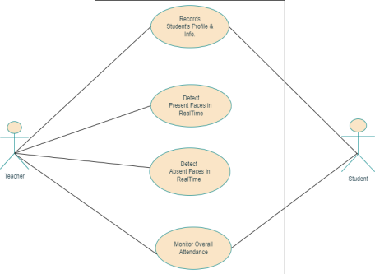
Models/Diagrams
10
USE CASE

Slide 11
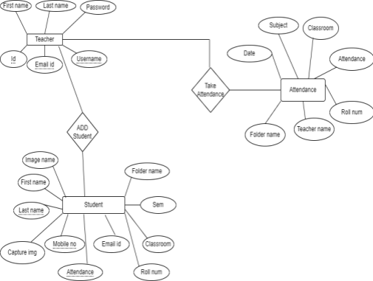
Models/Diagrams
E-r

Slide 12
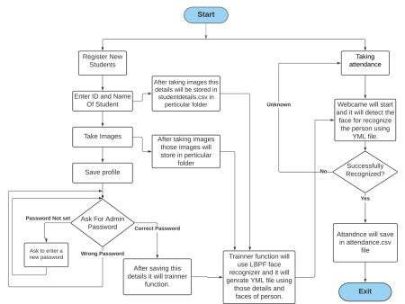
Models/Diagrams
Dfd

Slide 13
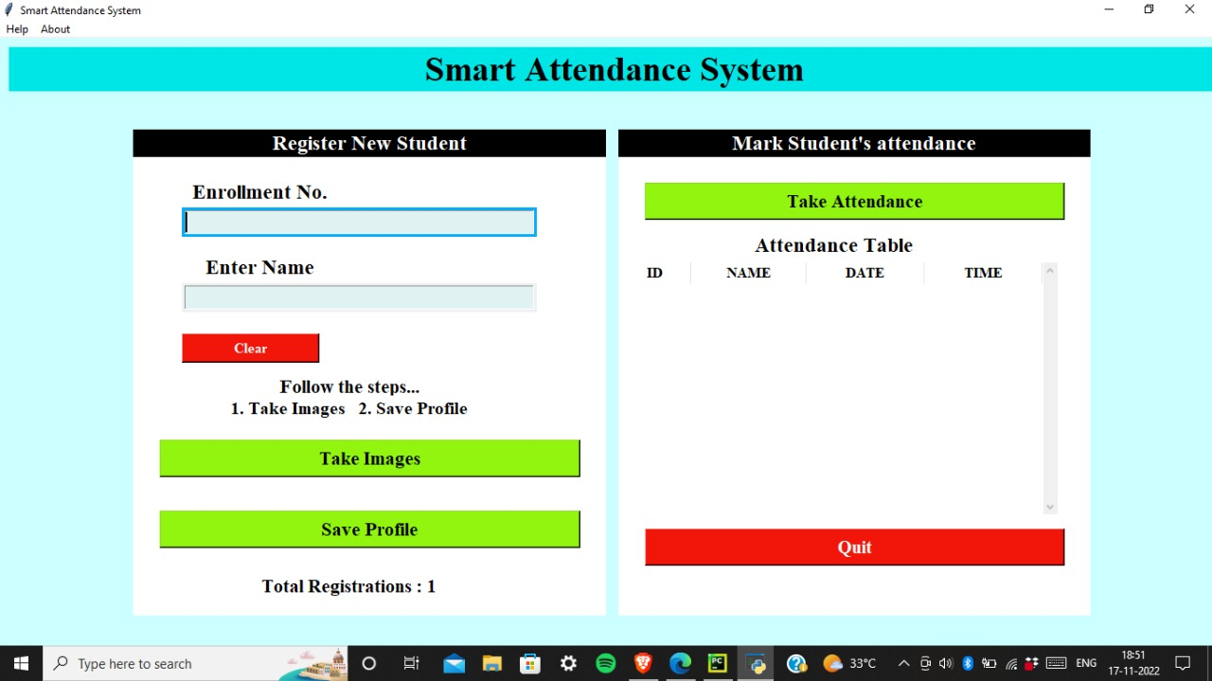
Implementation
11

Slide 14
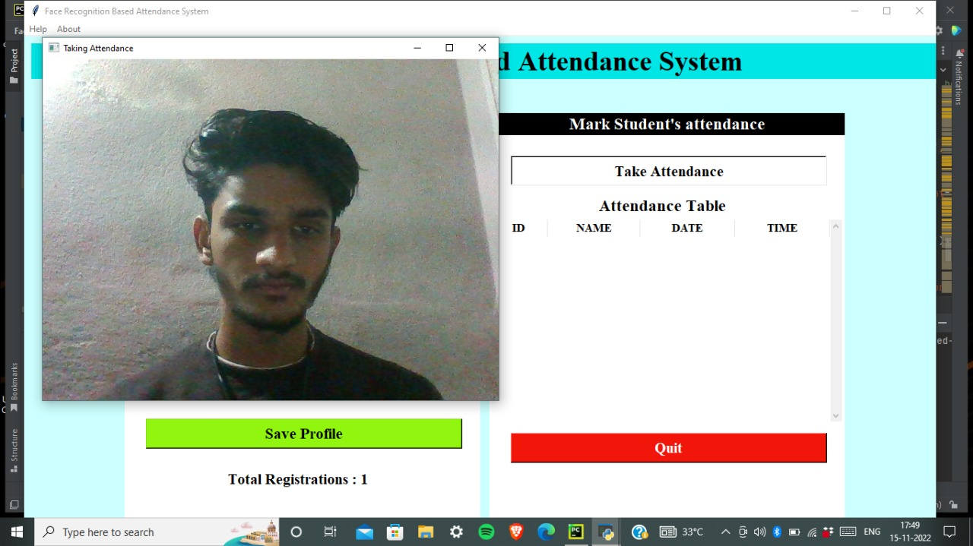
Implementation

Slide 15
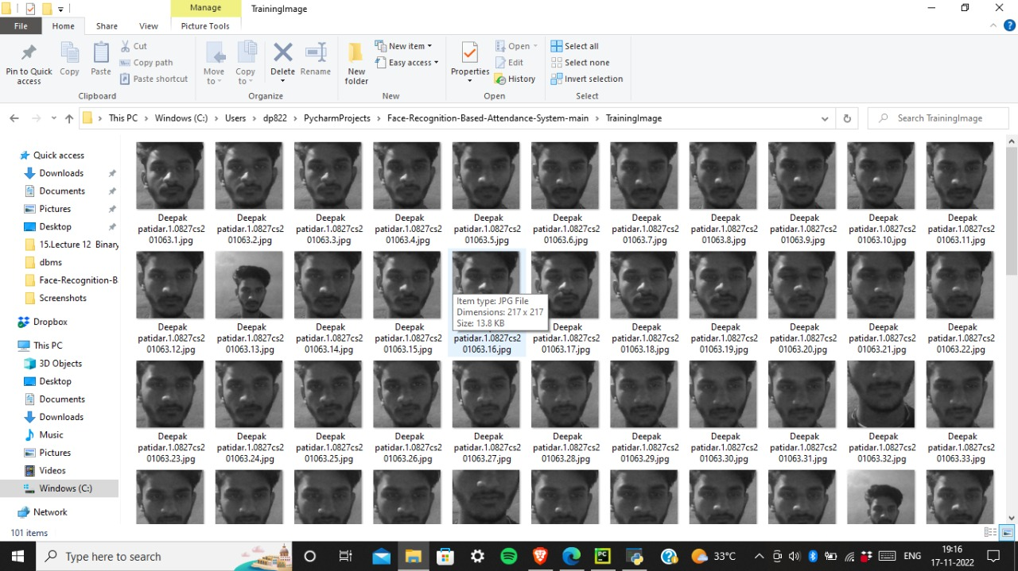
Implementation

Slide 16
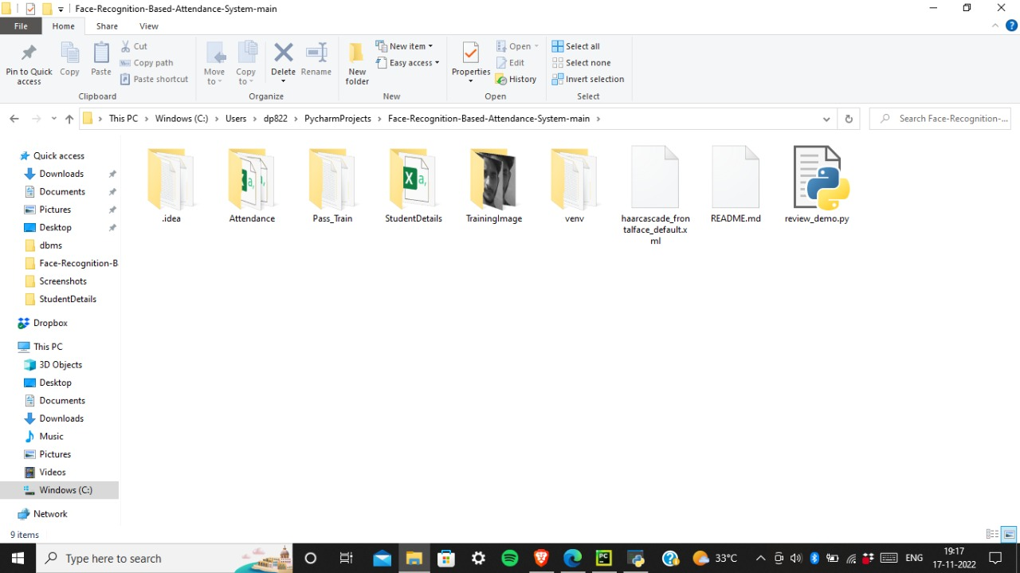
Implementation

Slide 17
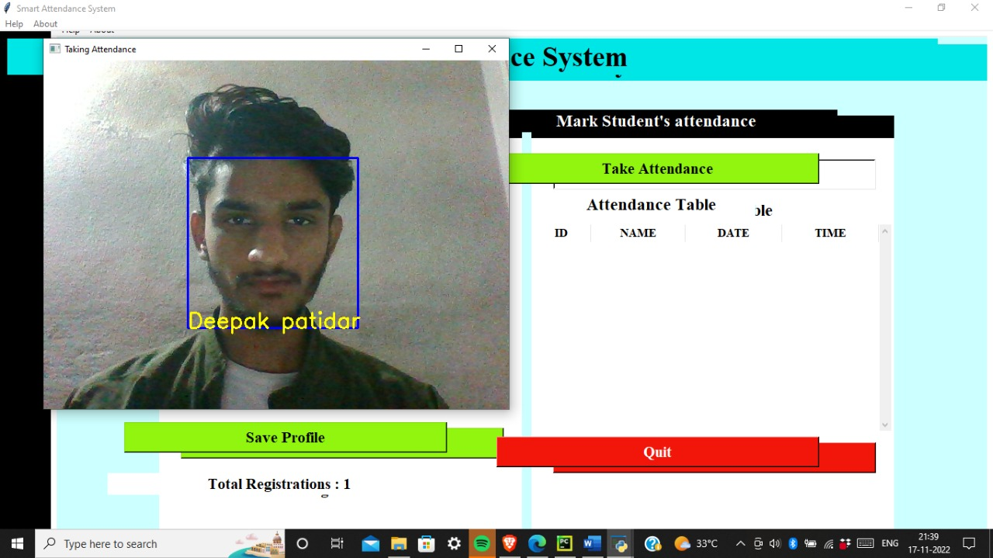
Testing/Test Cases
12

Slide 18
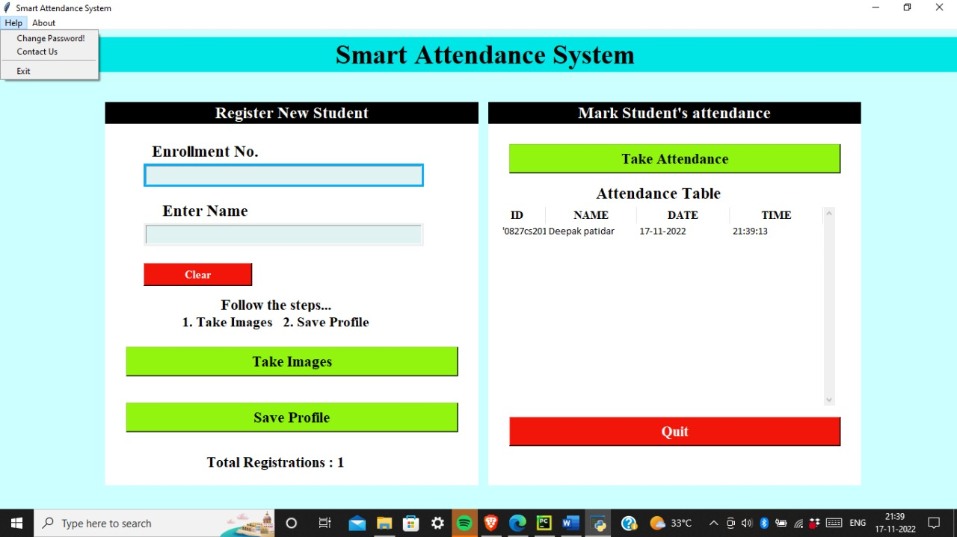
Testing/Test Cases

Slide 19
The Outcome discussion
13
The interface for the Smart Attendance System has been created. Using the interface the images of the individual students is being recorded and stored in the training dataset. Simultaneously their information is stored in the database i.e google spreadsheet . Finally the images of the students is being tracked and recognized and attendance is marked .

Slide 20
Conclusion and Limitation
14
Attendance System using Facial Recognition has been designed for the purpose of minimizing the labor work being done and decrease the errors that occur in the current manual attendance taking system. The goal is to automate and deploy a system that is useful to organizations like institutes or offices.
The implemented system works at optimum levels of efficiency in low-lit conditions up to a certain degree. The system can accurately recognizes faces between 80-90 percent of the time under normal daytime conditions. Future enhancements include improving the efficiency of the algorithm to detect faces at a farther distance, increase the capacity to recognize faces in low-lit environments and mark attendance for multiple faces detected at once.

Slide 21
Acknowledgment
15
We would like to thank to Smart India hackathon(SIH) for giving us an opportunity to implement this project. We would also like to extend our gratitude to our guides Mr. Ronak Jain Sir and prof. Narendra pal singh who gave us the right motivation and knowledgefull insight to complete this project.

